Slide 1

GENETIC ALGORITHMS
Submitted By -
Harshini Borugadda
23MCMI13
Guided By -
Dr. Naveen Nekuri
Assistant Professor, UOH

Slide 2
Contents
Introduction
Key Components
Pseudocode
Initialization
Fitness Evaluation
Selection
Cross-over
Mutation
Stopping Criteria
References

Slide 3
Introduction
Genetic Algorithms are inspired by nature’s process of eliminating things that don’t work and progressing with things that work.
Genetic algorithms are search heuristics that mimic the process of natural selection to solve optimization and search problems.
We work with a population of individuals — each individual is a solution to the problem. We pick the individuals who seem to be better solutions and use those to create a new population. And repeat this process.

Slide 4
Key Components
Population:
Set of potential solutions encoded as numbers.
Each individual represents a solution.
Fitness Function:
Evaluate the quality of each solution.
Assign fitness scores to each individual.
Selection:
Chooses individuals from the population for parents.
Common methods include roulette wheel and tournament selection.

Slide 5
Key Components
Crossover (Recombination):
Combines genetic information from two parents.
Creates new offspring solutions.
Mutation:
Introduces random changes in individuals.
Maintains genetic diversity.
Termination Condition:
Determines when the algorithm should stop.

Slide 6
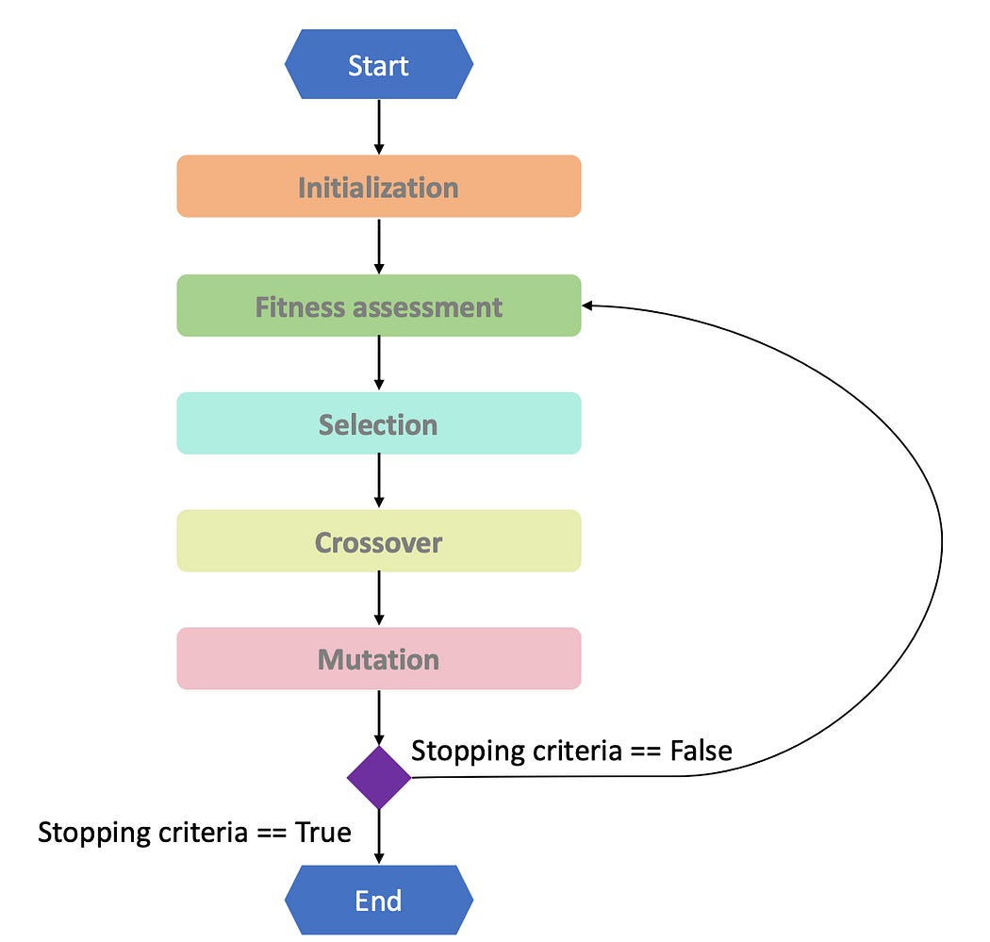
Pseudocode
Create an initial population of random candidate solutions (the first generation).
Define the problem and determine how a solution will be represented.
While (termination condition is not met):
Evaluate each solution in the population using a fitness function.
Select parent solutions based on their fitness scores.
Crossover - combine genetic information from parents to create new offspring.
Mutation - introduce small random changes to some offspring to maintain diversity.
Replace some or all of the current population with the new offspring.
Go back to step (a) with this new population.
Return the best solution found.
Src: https://blog.devgenius.io/the-different-parts-of-a-genetic-algorithm-487c5443e165

Slide 7
Initialization
Randomly define N possible solutions to the problem.
These solutions serve as the seed for the best solution.
Create initial set of possible solutions in the optimal solution region.
Provide pseudo-random guesses on the ideal solution.
Avoid overdoing to avoid getting stuck in local optima instead of global best solution.

Slide 8
Fitness Evaluation
Evaluate N possible solutions individually.
Fitness is a metric representing individual solution performance.
High fitness indicates well-optimized solutions.
A low score indicates incorrect solutions.
Minimization problems may require the best solution with the lowest value.

Slide 9
Selection
Selection based on previously computed fitness.
Higher fitness increases chances of being chosen as a parent and producing offspring.
The selection process is executed multiple times until sufficient parents are obtained.
Each parent can be selected multiple times and paired with different partners.
Selection procedure ensures to maintain Explore – Exploit Strategy.

Slide 10
Selection
Evaluating solutions or individuals in your population
Using a selection strategy to select the ones you want to keep
Evaluating
Creating some function that takes in the individual or solution as input, and outputs a quantitative estimate — or a fitness score — a number indicating how good it is a solution.
NOTE: Choose the evaluation function carefully — a wrong choice would lead you to a bad kind of solution, and you’ll end up thinking the whole algorithm sucks. An incorrect evaluation function won’t throw an error, it will just take you to a different kind of solution. Make sure a high-scoring solution is always preferable over a low-scoring solution.

Slide 11
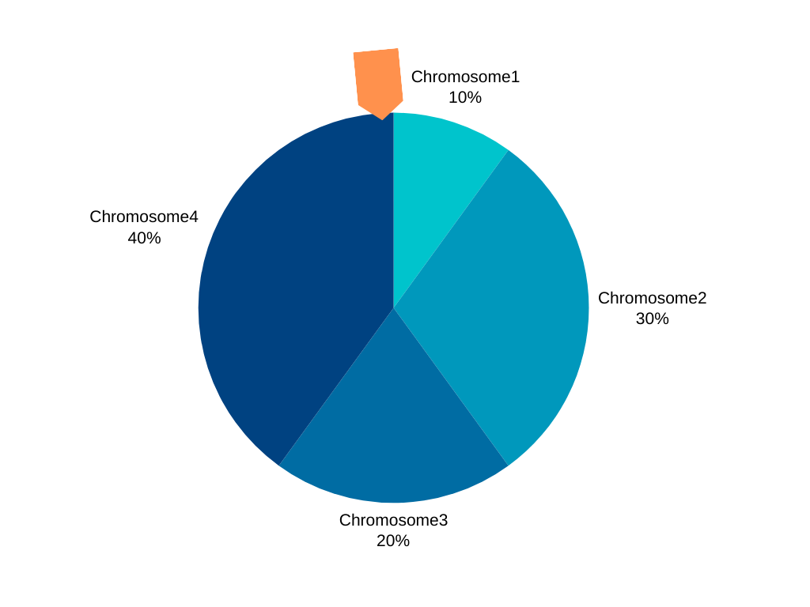
Selection
Roulette Wheel selection
Every solution is assigned a probability.
The roulette wheel selection method calculates fitness probabilities by adding fitness metrics for each solution and assigning a probability of selection based on individual fitness.
The probability is based on the fitness score — the more fit the solution, the higher the probability.
The probabilities of getting picked as a fit solution is proportional to the fitness — double fitness means double probability.

Slide 12
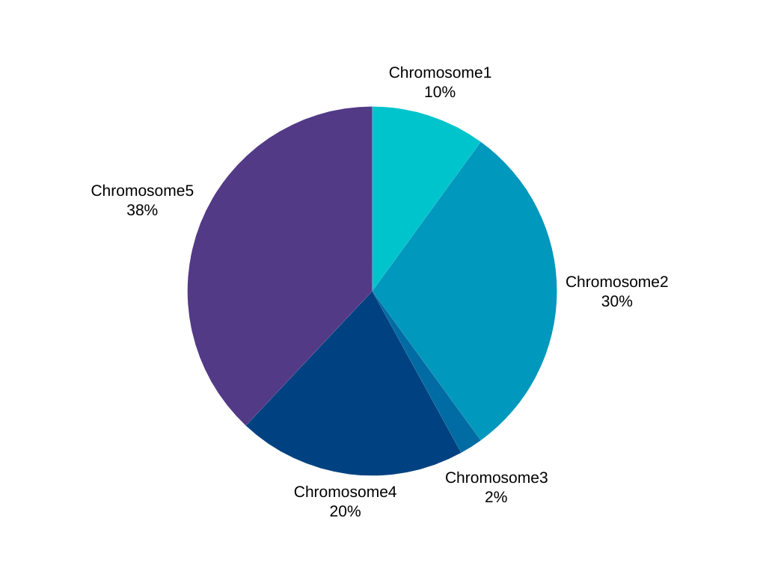
Selection
Rank selection
This involves ranking solutions using the fitness function from worst to best, dividing them into worsening numbers, and then adding them up to compute the probability.
NOTE: The Rank Selection method is similar to Roulette Wheel Selection, it assigns probabilities but is not proportional to the fitness. It gives each solution a ranking based on their fitness and then assigns probabilities. So double the fitness does not mean double the chance of getting picked. In some cases, this helps maintain diversity.

Slide 13
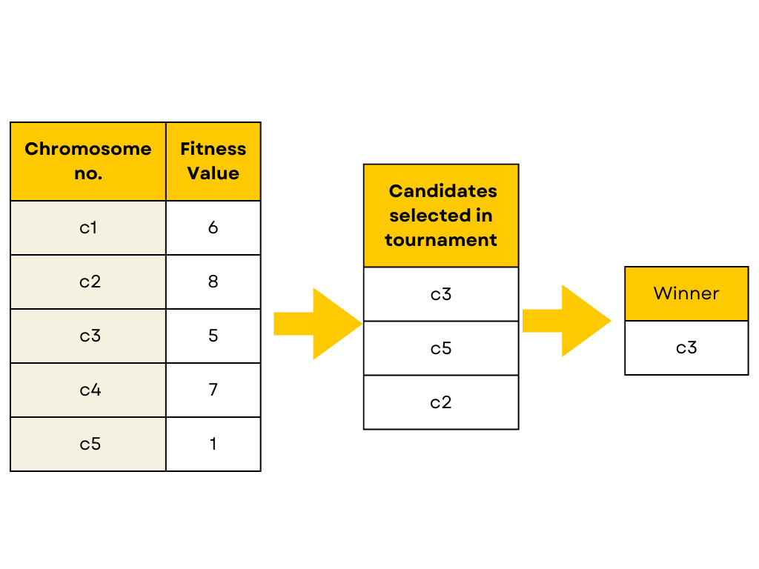
Selection
Tournament Selection
Pick ‘n’ random solutions from the population.
Select the best of that subset (those n solutions) as a fit solution. Or a fit parent for crossover.
Repeat K times to get K parents.
NOTE: There are some other methods (less important) like the Steady-state method and elitist method — where some individuals from the population just live on as it is to the next generation. Why change it if it is good? Right? Just replacing the medium or poor performers with variants of the good solutions.

Slide 14
Crossover
Combining good solutions to create new solutions or individuals.
Reproduction occurs between two parent solutions.
Using more parents in the population may enhance algorithm performance.
Crossover involves combining genetic information from two parents to create offspring.
Crossover can involve exchanging fixed sections or selecting random bits from each parent.
Maintaining solution validity is crucial, ensuring offspring represent feasible solutions.
Each element in the offspring is picked from parent A or parent B with equal probability.

Slide 15
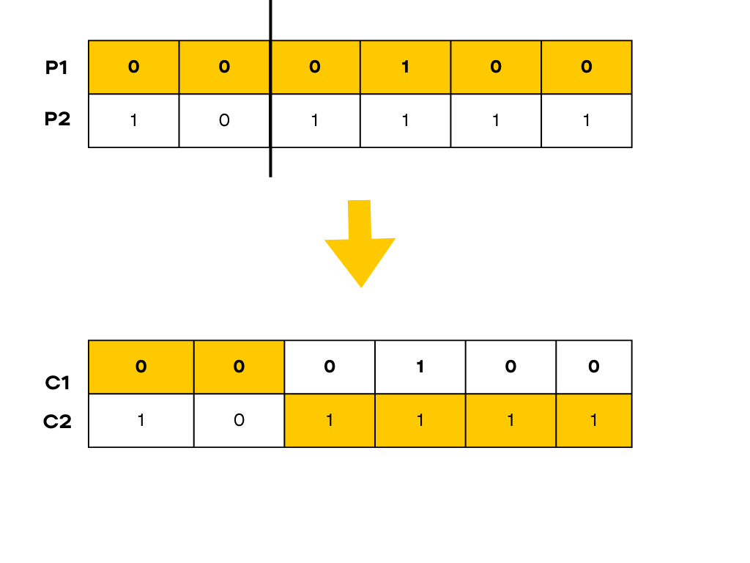
Crossover
One point crossover

Slide 16
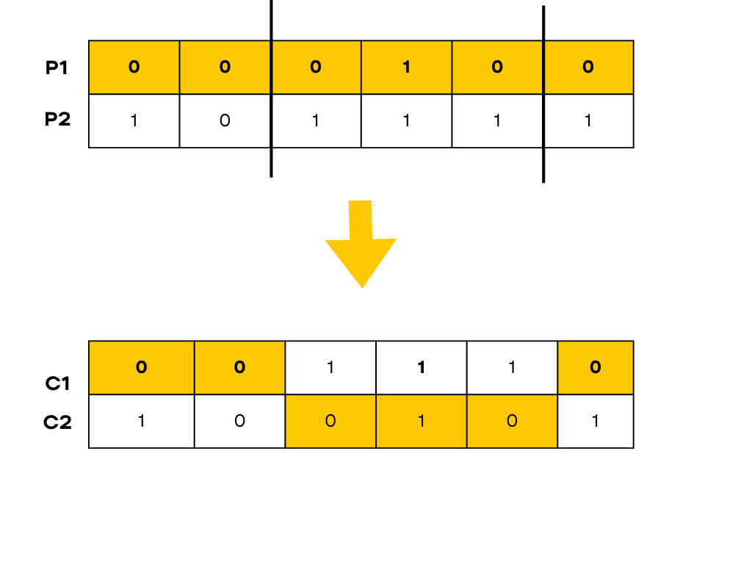
Crossover
Two-point crossover

Slide 17
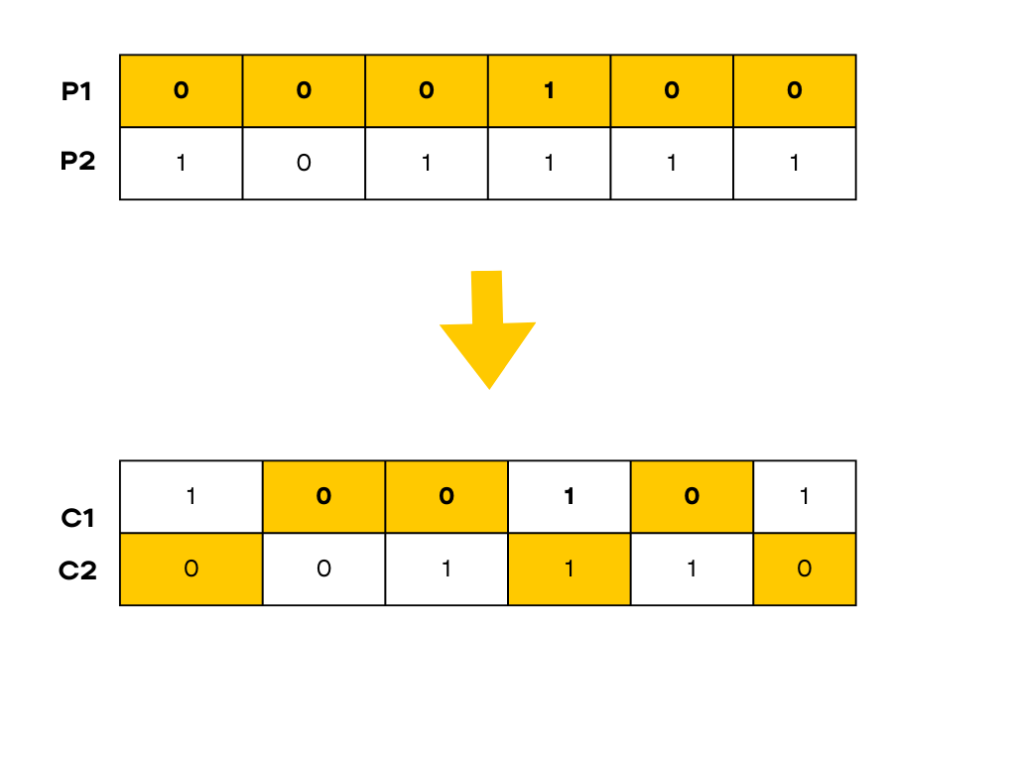
Crossover
Uniform crossover

Slide 18
Mutation
Making slight changes to the resulting offspring solution to add randomness and explore.
• Mutating prevents the algorithm from getting stuck at local optima.
• Local optimum is the best solution based on nearby solutions, but not the best possible solution.
• Randomness is generated by the mutation step to jump across hills.
• The mutation step changes different parts of the solution arbitrarily.
• Too little randomness can get stuck at the local optima, while too much can break the best solutions.
• Some implementations have inclusion criteria for offspring, filtering out bad offspring.
• Mechanisms prevent offspring from being too similar for variation.
• Higher variation increases the chances of achieving a better solution.

Slide 19
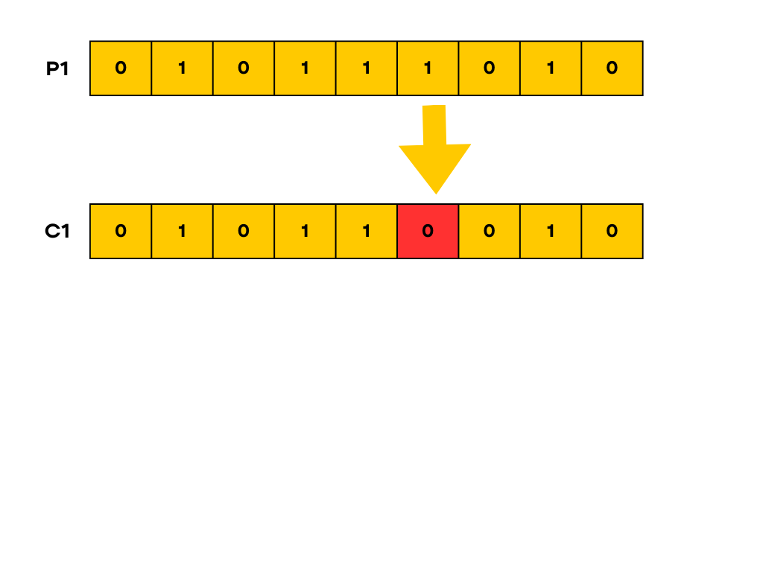
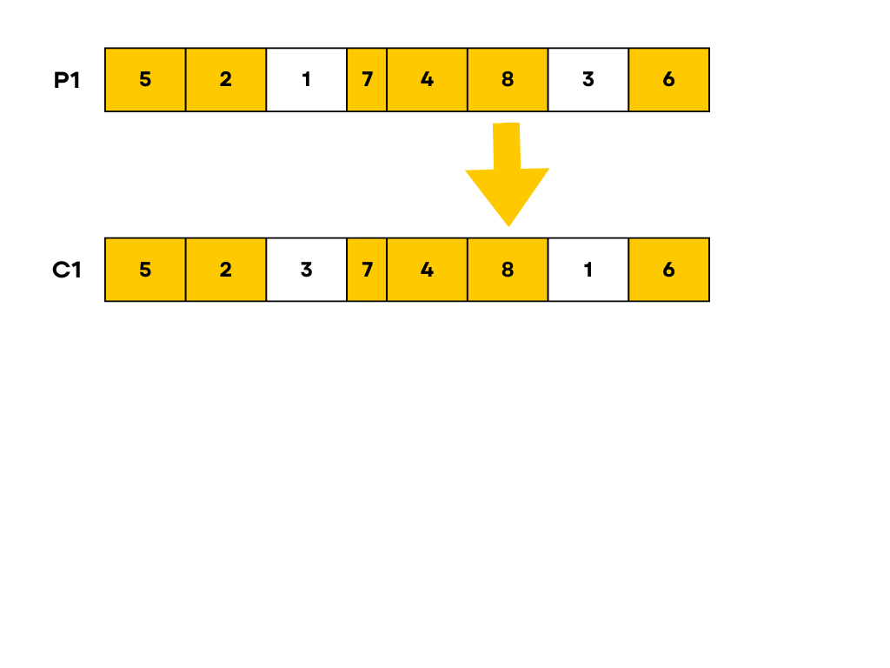
Mutation
Mutation on Binary–coded Chromosome
Swap - Mutation

Slide 20
Stopping Criteria
• If the minimum criteria are met, the execution is stopped.
• If not, the process is repeated.
• A set of rules can be defined to stop the computation.
• If the algorithm has looped enough times, no better solution is found.
• If the budget has been spent, there are no more resources to continue iterating.
• If the solution plateaus, the algorithm seems unable to find a better solution.
• If the solution is satisfactory, the experiment is stopped.
• A combination of all criteria can be used to find the best stopping rule.

Slide 21
References
https://blog.devgenius.io/the-different-parts-of-a-genetic-algorithm-487c5443e165

Slide 22
Thank You

